Slide 1
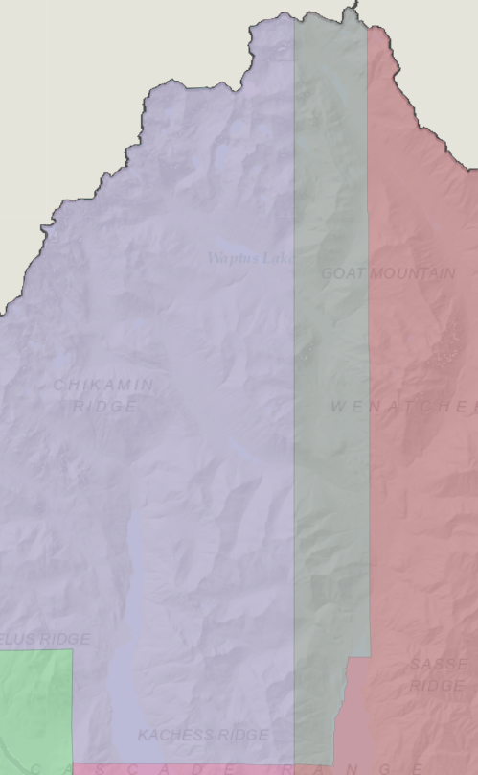


Change 1: Eastern Boundary of Kachess moves east and takes part of Mountain to align with the Cle Elum-Roslyn School District boundary. Change does not affect any boundaries south of Section 18.
Kachess

Slide 2
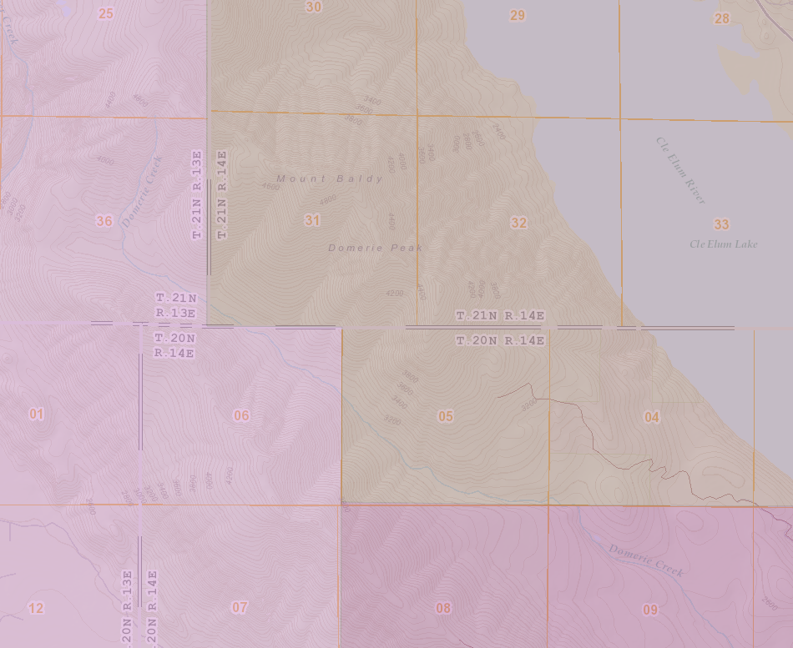
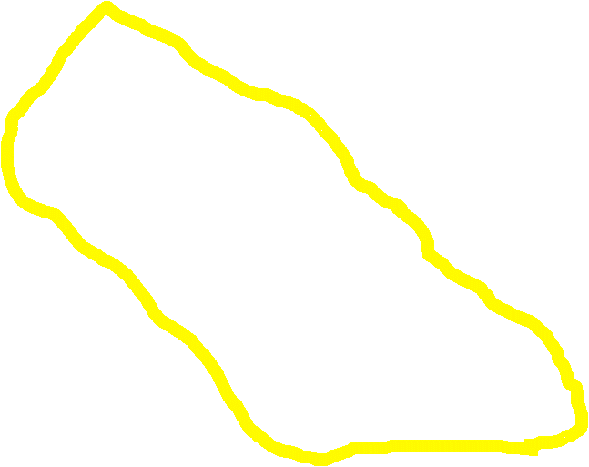
Change 1A: Map change to accurately reflect Precinct boundary description for Roslyn water shed (currently represented as part of Kachess and Mountain Precincts)
Mountain
Roslyn
Kachess
Roslyn Outlying

Slide 3
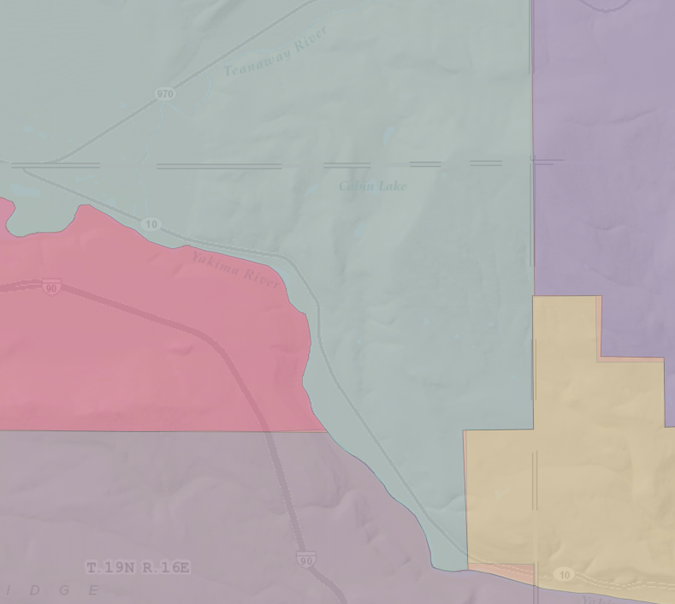

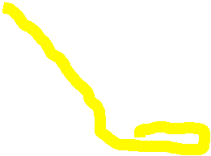
Change 2: Southeastern boundary of Teanaway extends east to align with Cle Elum-Roslyn School District Boundary
Teanaway

Slide 4
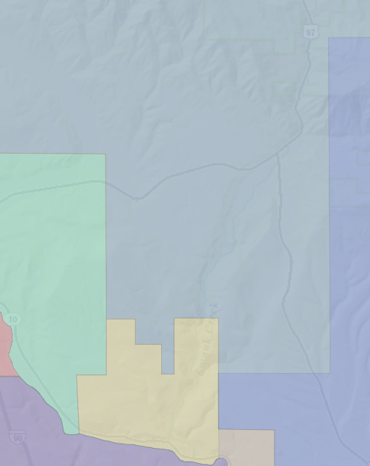


Change 3: Swauk Boundary moves south and takes part of Dry Creek to align with Upper/Lower Court District Boundaries.
Swauk

Slide 5
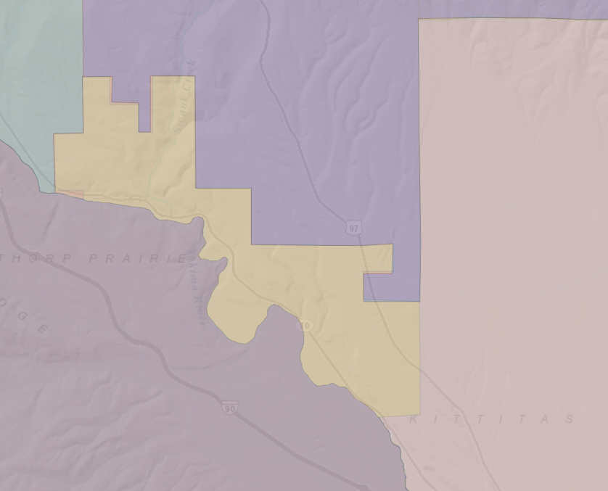

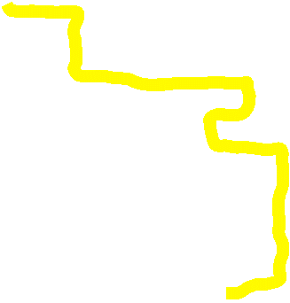

Change 4: Thorp Boundary extends north across the Yakima River and aligns with the Thorp School District Boundary
Teanaway
Swauk
Dry Creek
Thorp

Slide 6
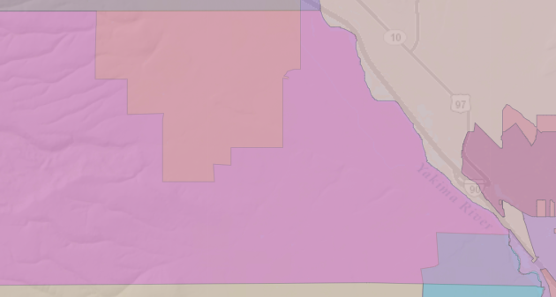


Change 5: Southeastern corner of Ridgeview boundary realigns to the Damman School District boundary.
Ridgeview

Slide 7
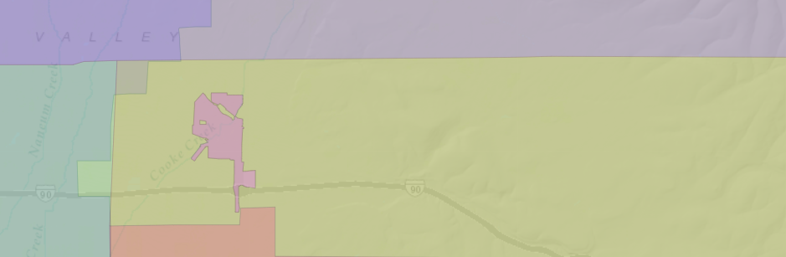

Change 6: Western Boundary of Park aligns to the Kittitas School District Boundary.
Park

Slide 8
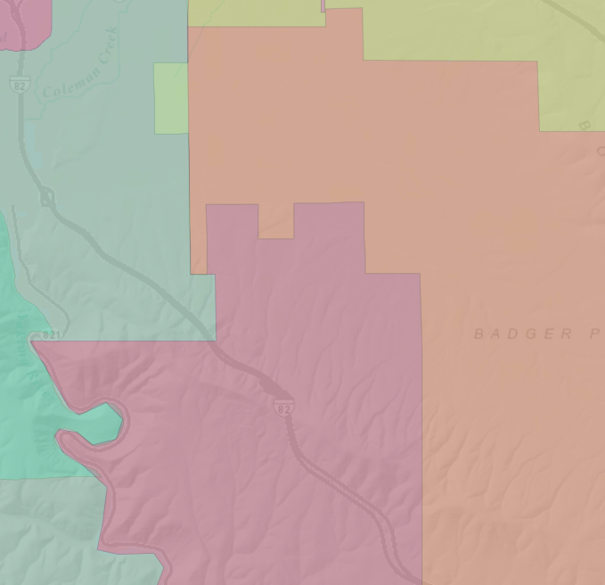


Change 7A: Denmark boundary extends west and aligns with Kittitas School District boundary vicinity of South Ferguson Road
Denmark

Slide 9
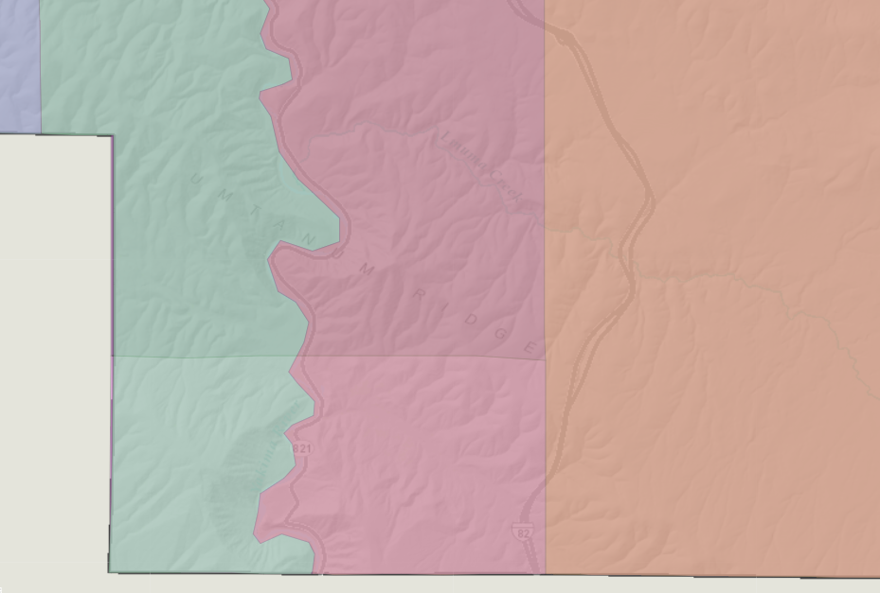


Change 7B: Denmark boundary extends west and takes southern part of Thrall to consolidate all of Selah School District into Denmark
Denmark

